Slide 1



OPOSEC
OSINT
PRIVATE BUSINESS, PUBLIC FALLOUT
Private Business, Public Fallout
How OSINT Took Down Portugal's Government
Guide on how to obtain the public information behind the recent scandal involving the Portuguese prime minister that led to the downfall of the government.
Page 01

Slide 2




OPOSEC
OSINT
PRIVATE BUSINESS, PUBLIC FALLOUT
Disclaimer & Legal Considerations
Presentation is solely for educational and awareness purposes.
Not a political statement.
Users must check the legality of OSINT tools and methods in their country.
This presentation is not related to my work or employer.
Page 01

Slide 3
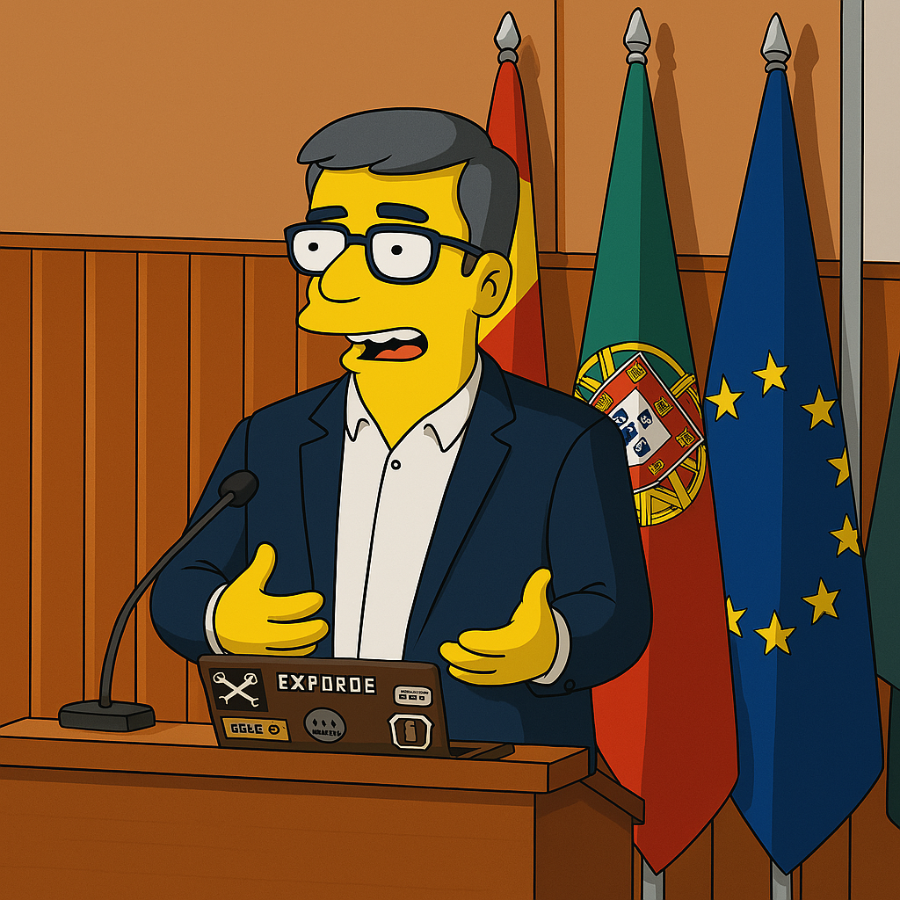
OPOSEC
OSINT
PRIVATE BUSINESS, PUBLIC FALLOUT
$whoami
👓 Pedro Vieira
🔐 Cybersecurity Engineer
🕵️ OSINT
✒️ Full stack developer
👨‍🏫 Public Speaker
Page 01

Slide 4
OPOSEC
OSINT
PRIVATE BUSINESS, PUBLIC FALLOUT
Agenda
OSINT
German Landscape
Common Attack Vectors
Page 01

Slide 5
OPOSEC
OSINT
PRIVATE BUSINESS, PUBLIC FALLOUT
OSINT
Flowchart
Page 01

Slide 6
OPOSEC
OSINT
PRIVATE BUSINESS, PUBLIC FALLOUT
OSINT
Flowchart
Page 01

Slide 7
OPOSEC
OSINT
PRIVATE BUSINESS, PUBLIC FALLOUT
Timeline
Jan 2024
04.04.2025
Texto
Oct 2024
Texto
Feb 2025
Texto
15.02.24
27.03.25
Texto
Jan | Feb | Mar | Apr | May | Jun | Jul | Aug | Sep | Oct | Nov | Dec | Jan | Feb | Mar | Apr
2024 |  |  |  |  |  |  |  |  |  |  |  | 2025
Feb / Mar 2024
Nov / Dec 2024
Texto
End of Mar 25
Texto
Page 01

Slide 8


OPOSEC
OSINT
PRIVATE BUSINESS, PUBLIC FALLOUT
Politicians - Membros do Governo/Parlamento
Membros do Governo (link)
Primeiro-Ministro (link)
Redes sociais
Deputados em funções (link)
Informação Pessoal (link)
Registo de interesses (link)
Participação em empresas (link)
Dados Abertos (link)
Page 01

Slide 9
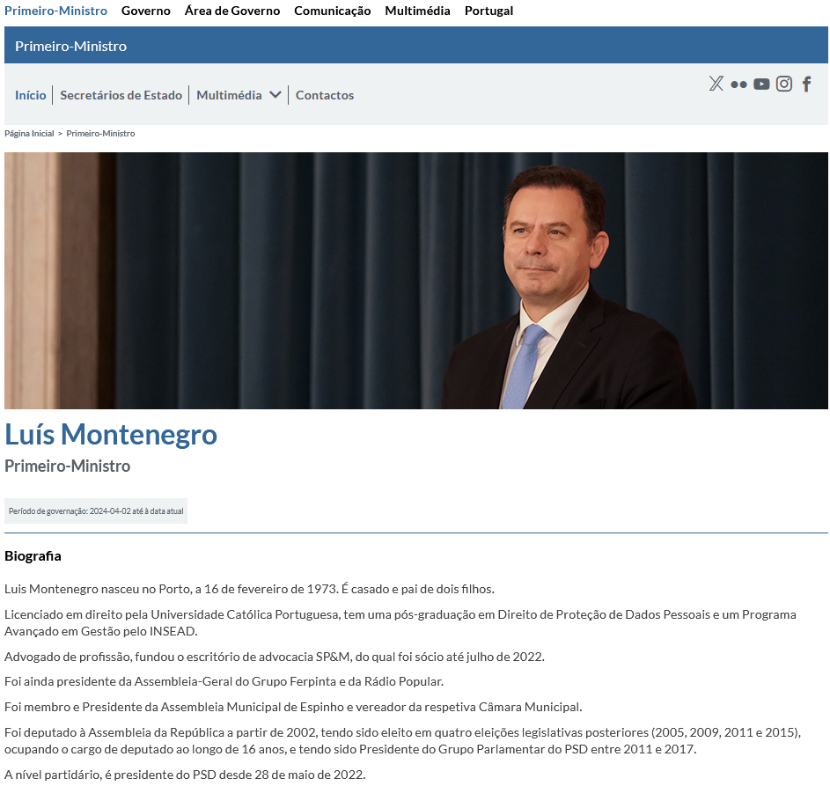
OPOSEC
OSINT
PRIVATE BUSINESS, PUBLIC FALLOUT
Portal do Governo
Portal do Governo (link)
Page 01

Slide 10
OPOSEC
OSINT
PRIVATE BUSINESS, PUBLIC FALLOUT
Prime-Minister
Name: Luís Montenegro
Birth: 16/02/1973 - Porto
Marital Status:
Married
2 children
Education:
Law graduate - Universidade Católica Portuguesa - 1999
Post-graduate degree in Personal Data Protection - INSEAD
Advanced Management Programme - INSEAD
Previous Job:
Lawyer – Founder and Partner of SP&M law firm
Chairman of the General Meeting of the Ferpinta Group
Chairman of the General Meeting of Rádio Popular
Politician:
Member and Chairman of the Espinho Municipal Assembly and Councillor
Member of Parliament in 2002, 2005, 2009, 2011, and 2015 (16 years)
President of the PSD Parliamentary Group from 2011 to 2017
Leader of the Social Democrats (PSD) since 28 May 2022
Page 01

Slide 11
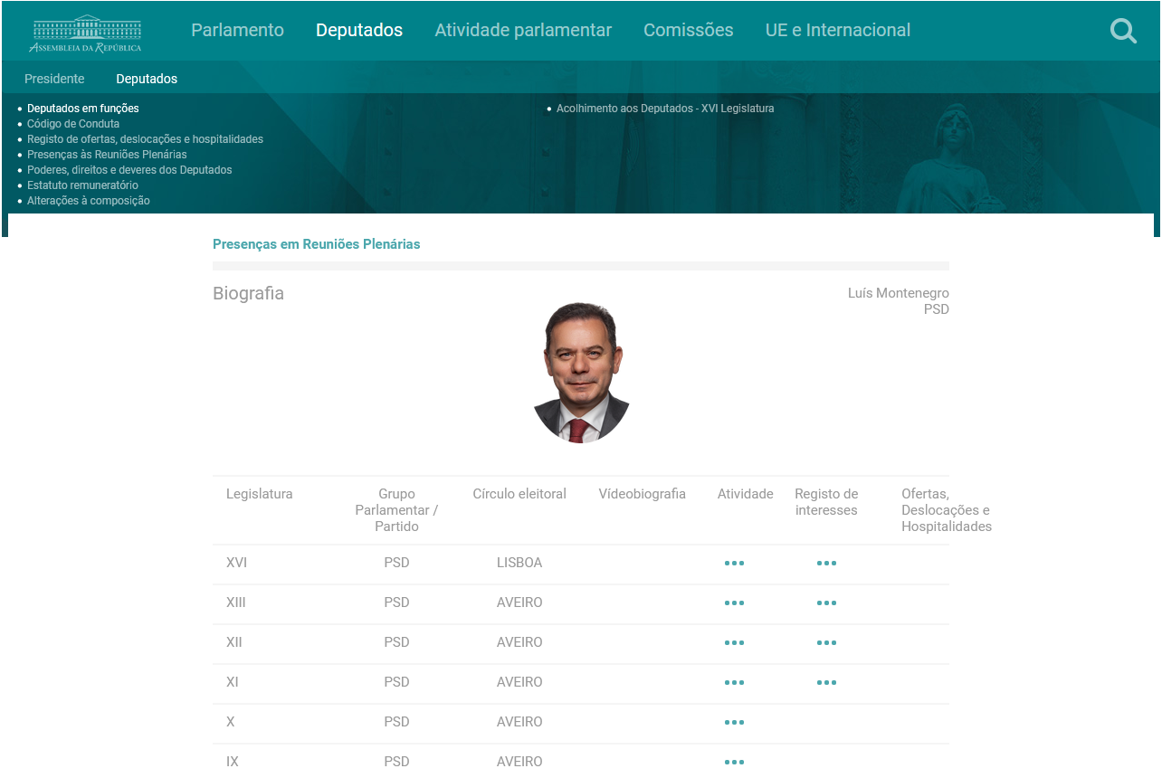
OPOSEC
OSINT
PRIVATE BUSINESS, PUBLIC FALLOUT
Assembleia da República
Registo de interesses
Legislatura XI (link)
Legislatura XII (link)
Legislatura XIII (link)
Legislatura XVI (link)
Page 01

Slide 12
OPOSEC
OSINT
PRIVATE BUSINESS, PUBLIC FALLOUT
Prime-Minister
Name: Luís Montenegro
Full Name: Luís Filipe Montenegro Cardoso de Morais Esteves
Birth: 16/02/1973 - Porto
Marital Status:
Married - Carla Maria Rodrigues Neto Montenegro
Comunhão de Adquiridos
2 children
Education:
Law graduate - Universidade Católica Portuguesa - 1999
Post-graduate degree in Personal Data Protection - INSEAD
Advanced Management Programme - INSEAD
Previous Job:
Lawyer – Founder and Partner of SP&M law firm - Porto (50%)
Chairman of the General Meeting of the Ferpinta Group
Chairman of the General Meeting of Rádio Popular
Oliveiras Gold de Portugal, Lda (25%) - Bragança
Luimonteago,Lda (95%) - Barcelos
Politician:
Member and Chairman of the Espinho Municipal Assembly and Councillor
Member of Parliament in 2002, 2005, 2009, 2011, and 2015 (16 years)
President of the PSD Parliamentary Group from 2011 to 2017
Leader of the Social Democrats (PSD) since 28 May 2022
Page 01

Slide 13
OPOSEC
OSINT
PRIVATE BUSINESS, PUBLIC FALLOUT
SOUSA PINHEIRO & MONTENEGRO - SOCIEDADE DE ADVOGADOS, SP, RL
Site einforma (link)
NIPC: 510445020
Denominação: SOUSA PINHEIRO & MARQUES - SOCIEDADE DE ADVOGADOS, SP, RL
Designações anteriores: SOUSA PINHEIRO & MONTENEGRO - SOCIEDADE DE ADVOGADOS, SP, RL
Website: https://spm-advogados.com/
DUNS:
Morada: PRAÇA BOM SUCESSO, 74/90 3º ESCRITÓRIO 7 – 4150-146 PORTO
Telefone
Email:
CAE: 69101 - Atividades jurídicas, exceto dos cartórios notariais
Page 01

Slide 14

OPOSEC
OSINT
PRIVATE BUSINESS, PUBLIC FALLOUT
Prime-Minister
Portal do Governo (link)
Page 01

Slide 15
OPOSEC
OSINT
PRIVATE BUSINESS, PUBLIC FALLOUT
Prime-Minister
Name: Luís Montenegro
Full Name: Luís Filipe Montenegro Cardoso de Morais Esteves
Birth: 16/02/1973 - Porto
Marital Status:
Married - Carla Maria Rodrigues Neto Montenegro
Comunhão de Adquiridos
2 children
Address:
Urbanização do Formal, nº 15
4500 - 669 Silvalde - Espinho
Education:
Law graduate - Universidade Católica Portuguesa - 1999
Post-graduate degree in Personal Data Protection - INSEAD
Advanced Management Programme - INSEAD
Previous Job:
Lawyer – Founder and Partner of SP&M law firm - Porto (50%)
Chairman of the General Meeting of the Ferpinta Group
Chairman of the General Meeting of Rádio Popular
Oliveiras Gold de Portugal, Lda (25%) - Bragança
Luimonteago,Lda (95%) - Barcelos
Politician:
Member and Chairman of the Espinho Municipal Assembly and Councillor
Member of Parliament in 2002, 2005, 2009, 2011, and 2015 (16 years)
President of the PSD Parliamentary Group from 2011 to 2017
Leader of the Social Democrats (PSD) since 28 May 2022
Page 01

Slide 16
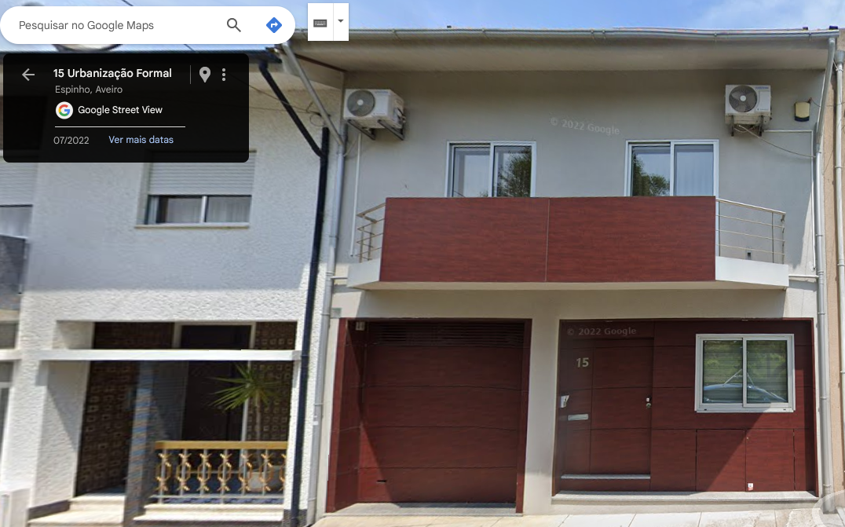
OPOSEC
OSINT
PRIVATE BUSINESS, PUBLIC FALLOUT
Prime-Minister
Portal do Governo (link)
Page 01

Slide 17
OPOSEC
OSINT
PRIVATE BUSINESS, PUBLIC FALLOUT
SOUSA PINHEIRO & MONTENEGRO - SOCIEDADE DE ADVOGADOS, SP, RL
SP&M (link)
Sócios: Paulo Sousa Pinheiro
CC – 10308852 0 ZY0 (contrato com cm espinho)
NIF – 217298524 (contrato com cm espinho)
WaybackMachine: (link)
Email: lmontenegro@spm-advogados.com
Advogado (cédula profissional n.º 44944P) – Inactivo (portal ordem dos advogados)
deputado na Assembleia Metropolitana do Porto
Page 01

Slide 18

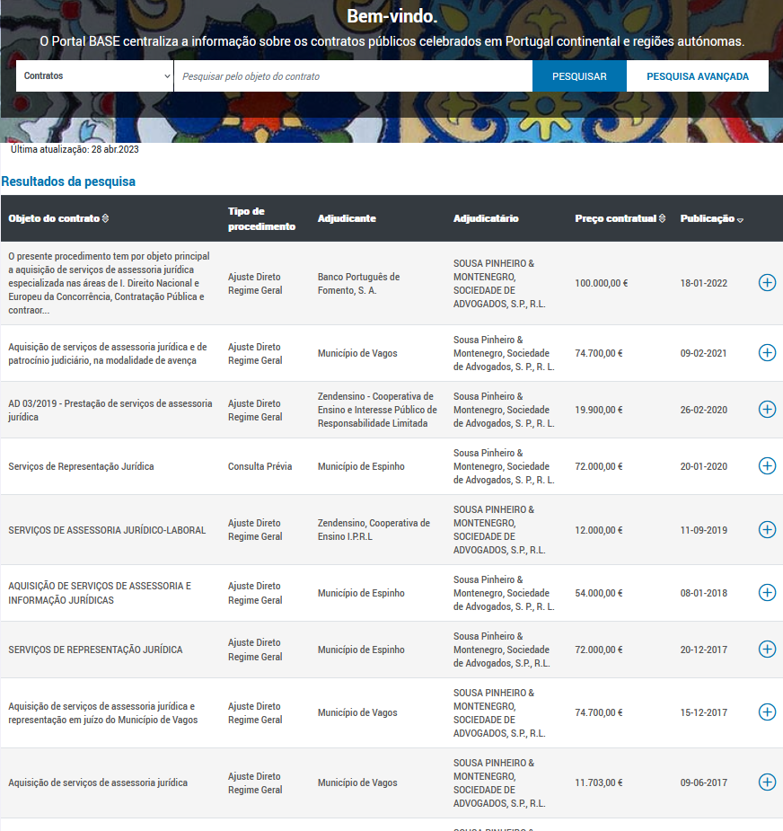
OPOSEC
OSINT
PRIVATE BUSINESS, PUBLIC FALLOUT
SOUSA PINHEIRO & MONTENEGRO - SOCIEDADE DE ADVOGADOS, SP, RL
Portal Base (link)
Contratos Públicos
Banco Português do Fomento
2022 – 1 contrato – 100.000€
Município de Espinho
2014/2019 – 337.311 €
Município de Vagos
2015/2021 – 209.409 €
Zendensino
2018/2020 – 31.900 €
Page 01

Slide 19
OPOSEC
OSINT
PRIVATE BUSINESS, PUBLIC FALLOUT
Oliveiras Gold de Portugal
Site einforma (link) racius (link)
NIPC: 510172466
Address:
Sortes 5300-903 Sortes - Bragança
Partners:
Page 01

Slide 20
OPOSEC
OSINT
PRIVATE BUSINESS, PUBLIC FALLOUT
Luimonteago, Lda
Site einforma (link) racius (link)
NIPC: 510347070
Sócios
Page 01

Slide 21
OPOSEC
OSINT
PRIVATE BUSINESS, PUBLIC FALLOUT
Spinumviva, Lda
Site einforma (link) racius (link)
NIPC: 516195174
Page 01

Slide 22
OPOSEC
OSINT
PRIVATE BUSINESS, PUBLIC FALLOUT
Spinumviva, Lda
Site einforma (link) racius (link)
NIPC: 516195174
Avenida 8, nº 320
4500 - 205 Espinho
Page 01

Slide 23
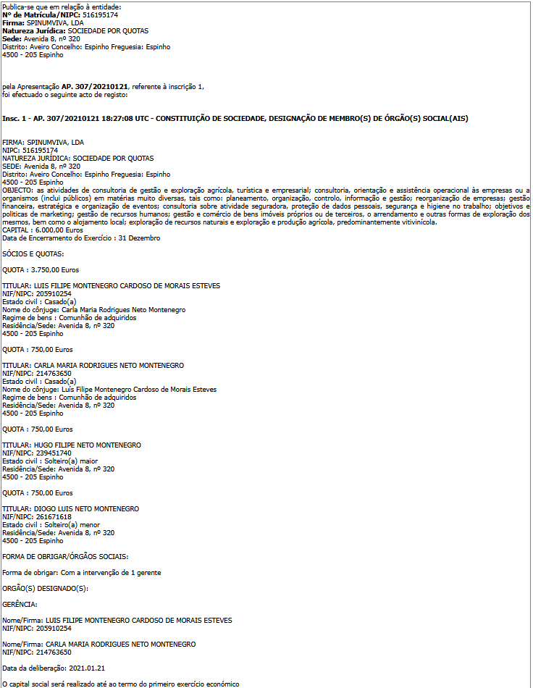
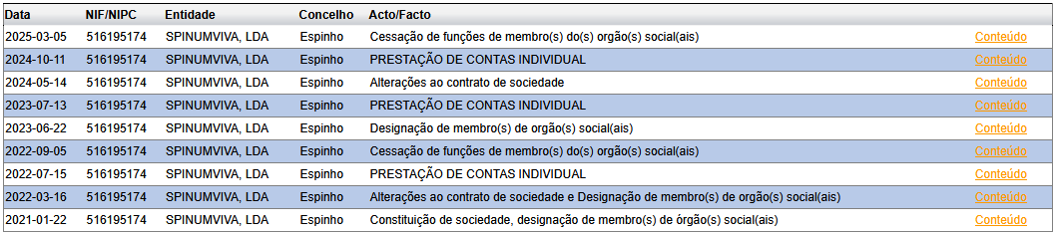
OPOSEC
OSINT
PRIVATE BUSINESS, PUBLIC FALLOUT
Spinumviva, Lda
Publicações de Atos Societários e de outras entidades (link)
Page 01

Slide 24
OPOSEC
OSINT
PRIVATE BUSINESS, PUBLIC FALLOUT
Spinumviva, Lda
Publicações de Atos Societários e de outras entidades (link)
Page 01

Slide 25
OPOSEC
OSINT
PRIVATE BUSINESS, PUBLIC FALLOUT
Empresas
Luimonteago,Lda - 510347070
Oliveiras Gold de Portugal, Lda - 510172466
SP&M, Sociedade de Advogados, RL - 510445020
Grupo Ferpinta, SA - 501756710
Radio Popular - Eletrodomésticos, SA - 500674205
Page 01

Slide 26
OPOSEC
OSINT
PRIVATE BUSINESS, PUBLIC FALLOUT
Links
https://www.instagram.com/observador/p/DGO47HZzzOA/?utm_source=chatgpt.com&img_index=5
https://www.instagram.com/cnnportugal/reel/DGHU11hMFuA/a-mulher-e-os-filhos-de-lu%C3%ADs-montenegro-t%C3%AAm-uma-empresa-imobili%C3%A1ria-o-que-pode-c/
https://bibliotecamunicipal.espinho.pt/fotos/documentos/4144_01_09_2011_171749118060017cf5403bb.pdf
https://www.linkedin.com/feed/update/urn:li:activity:7312463193816133632/
Page 01

Slide 27

OPOSEC
OSINT
PRIVATE BUSINESS, PUBLIC FALLOUT
THANK YOU
Q&A
Page 01

Slide 28




STUDIO SHODWE
HOME
SERVICE
ABOUT US
CONTACT US
COMPUTER
TECHNOLOGY
A project is a series of planned tasks with a clear objective, often involving multiple steps. It can be carried out by individuals or teams and is designed to achieve specific outcomes within a set timeframe.
Page 01

Slide 29

STUDIO SHODWE
HOME
SERVICE
ABOUT US
CONTACT US
INTRODUCTION
A project refers to a sequence of tasks that are carefully planned and executed to achieve a specific objective. Projects are essential in various fields, such as business, engineering, and education, and often require collaboration and resources. Each project has a start and an end, along with defined goals and deliverables. The success of a project is usually determined by how effectively the team meets the objectives within the allocated time and resources.
A project refers to a sequence of tasks that are carefully planned and executed to achieve a specific objective.
Page 02

Slide 30


STUDIO SHODWE
HOME
SERVICE
ABOUT US
CONTACT US
HARDWARE
COMPONENTS
CENTRAL PROCESSING UNIT (CPU)
MEMORY (RAM & STORAGE)
A project refers to a sequence of tasks that are carefully planned and executed to achieve a specific objective. Projects are essential in various fields, such as business, engineering, and education, and often require collaboration and resources. Each project has a start and an end, along with defined goals and deliverables.
A project refers to a sequence of tasks that are carefully planned and executed to achieve a specific objective. Projects are essential in various fields, such as business, engineering, and education, and often require collaboration and resources. Each project has a start and an end, along with defined goals and deliverables.
Page 03

Slide 31


STUDIO SHODWE
HOME
SERVICE
ABOUT US
CONTACT US
SOFTWARE
COMPONENTS
A project refers to a sequence of tasks that are carefully planned and executed to achieve a specific objective. Projects are essential in various fields, such as business, engineering, and education, and often require collaboration and resources. Each project has a start and an end, along with defined goals and deliverables. The success of a project is usually determined by how effectively the team meets the objectives within the allocated time and resources.
A project refers to a sequence of tasks that are carefully planned and executed to achieve a specific objective. Projects are essential in various fields, such as business, engineering, and education, and often require collaboration and resources.
Page 04

Slide 32



STUDIO SHODWE
HOME
SERVICE
ABOUT US
CONTACT US
NETWORKING
& THE INTERNET
A project is a series of planned tasks with a clear objective, often involving multiple steps. It can be carried out by individuals or teams and is designed to achieve specific outcomes within a set timeframe.
A project is a series of planned tasks with a clear objective, often involving multiple steps. It can be carried out by individuals or teams and is designed to achieve specific outcomes within a set timeframe.
Page 05

Slide 33



STUDIO SHODWE
HOME
SERVICE
ABOUT US
CONTACT US
DATA
MANAGEMENT
DATABASE
DATA & SECURITY
DATA ANALYTICS
A project is a series of planned tasks with a clear objective, often involving multiple steps. It can be carried out by individuals or teams and is designed to achieve specific outcomes within a set timeframe.
A project is a series of planned tasks with a clear objective, often involving multiple steps. It can be carried out by individuals or teams and is designed to achieve specific outcomes within a set timeframe.
A project is a series of planned tasks with a clear objective, often involving multiple steps. It can be carried out by individuals or teams and is designed to achieve specific outcomes within a set timeframe.
Page 06

Slide 34


STUDIO SHODWE
HOME
SERVICE
ABOUT US
CONTACT US
ARTIFICIAL
INTELLIGENCE
A project is a series of planned tasks with a clear objective, often involving multiple steps. It can be carried out by individuals or teams and is designed to achieve specific outcomes within a set timeframe.
A project is a series of planned tasks with a clear objective, often involving multiple steps. It can be carried out by individuals or teams and is designed to achieve specific outcomes within a set timeframe.
Page 07

Slide 35

STUDIO SHODWE
HOME
SERVICE
ABOUT US
CONTACT US
CYBER
SECURITY
A project is a series of planned tasks with a clear objective, often involving multiple steps. It can be carried out by individuals or teams and is designed to achieve specific outcomes within a set timeframe.
A project is a series of planned tasks with a clear objective, often involving multiple steps. It can be carried out by individuals or teams and is designed to achieve specific outcomes within a set timeframe.
Page 08

Slide 36



STUDIO SHODWE
HOME
SERVICE
ABOUT US
CONTACT US
FUTURE
IN TECHNOLOGY
A project is a series of planned tasks with a clear objective, often involving multiple steps. It can be carried out by individuals or teams and is designed to achieve specific outcomes within a set timeframe.
A project is a series of planned tasks with a clear objective, often involving multiple steps. It can be carried out by individuals or teams and is designed to achieve specific outcomes within a set timeframe.
Page 09

